Slide 1

Introduction of Quantitative Investing with Machine Learning
Professor Haifeng YOU
2021.10.21

Slide 2
Plan
Three pillars of quantitative investing
Evaluation of alpha factors
Framework for factor discovery
Application of machine learning in factor discovery

Slide 3
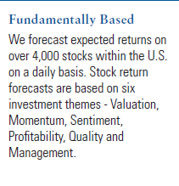
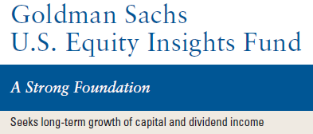
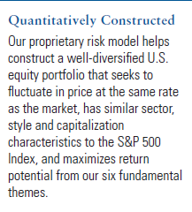
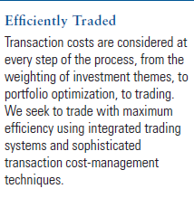
An Example of Quantitative Equity Fund: GS US Equity Insights Fund

Slide 4
Key Element of Quantitative Investment
Quantitative Equity Investing
Alpha
Return Prediction
Alpha model (α)
Forecast and maximize future expected return
Most important element (our focus)
Risk
Risk model (σ)
Forecast and control for portfolio risk
T-cost
Transaction cost
Transaction cost model (c)
Forecast and minimize transaction cost

Slide 5
Quantitative investment process
Multi-Factor Stock Selection Model
(Return Forecast)
Statistically-Based Risk Model
(Risk Forecast)
Transaction Cost Model
(T-cost Forecast)
Optimizer
Optimal Holding & Trading Lists
(Balance return, risk and t-cost)
Portfolio Manager
Qualitative Confirmation
Prevent False Positives
Trader
Efficient Trading & Implementation

Slide 6

Putting Them Together to Build Portfolio
In constructing optimal portfolio, portfolio managers maximize the following objective function:
$U= E\left(R\right) − TC$ $−\text{λ}σ^{2}$
Investor utility
E(R) =
Expected active return of portfolio
(alpha)
TC =
Transaction cost
σ² = Portfolio risk
= risk aversion parameter
(how much you hate volatility)
Main Job
Commercially available from MSCI Barra, Axioma, Northfield, etc.

Slide 7
Alpha (α) Model
Alpha is an aggregate of individual factors/signals that predict future returns (i.e. ex ante return forecasts)
Factors/signals
Firm characteristics expected to be predictive of future returns
e.g. Book-to-market ratio

Slide 8
Factor-Based Strategies (Factor Investing)
A factor is a variable or characteristic that drives, or correlates with asset returns.
When such factors are identified, they can be used to rank stocks for investment with the aim of predicting future returns or risks.
Typical examples are the size and value factors introduced by Fama and French (1993) in their multifactor model.
They noticed that smaller companies tend to offer higher returns than larger companies (the size factor), and stocks with higher book values relative to market values tended also tended to outperform (the value factor).

Slide 9
Portfolio Approach for Factor Evaluation
Identify a quantifiable stock characteristics expected to predict future stock returns (e.g. B/M)
Sort all stocks in the investment universe by the characteristics into deciles (i.e. ten equally sized portfolios) each month/year/day
Calculate the time-series of portfolio returns for the 10 decile portfolios over the sample period
Compute the average return, volatility, turnover, and other characteristics for the 10 decile portfolios as well as the hedge portfolio that takes long (short) position in the top (bottom) decile

Slide 10
Portfolio Approach for Factor Evaluation
Do the top deciles have better returns than the bottom deciles?
Does the hedged portfolio, i.e. the top-minus-bottom portfolio generate consistent return performance over time?
Is the relationship (between decile rank and average returns) monotonic?

Slide 11
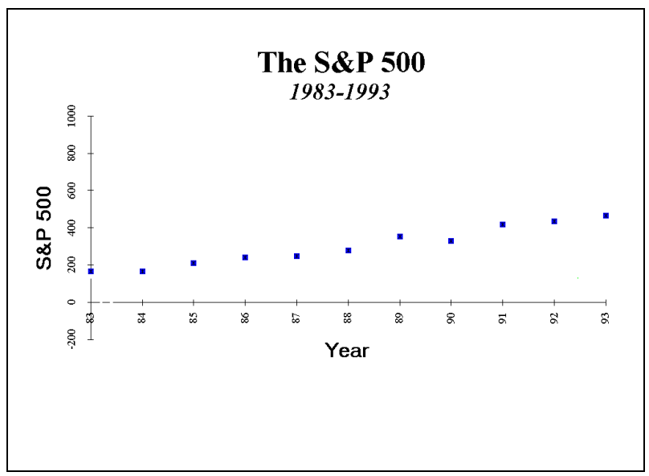
What is the best predictor of S&P 500 Index?

Slide 12
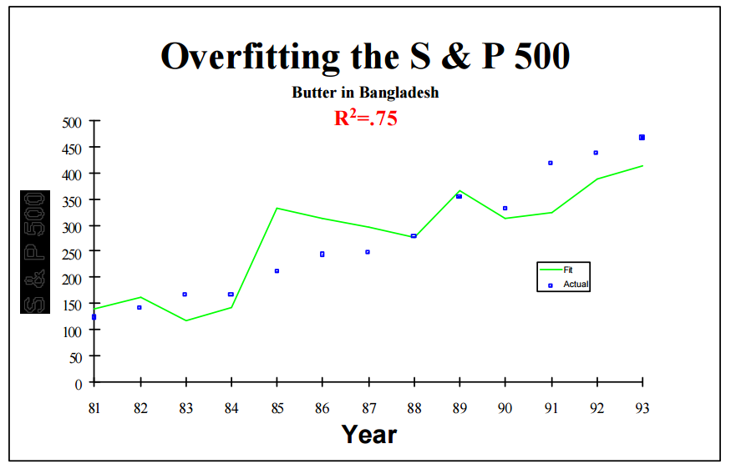

What is the best predictor of S&P 500 Index?

Slide 13
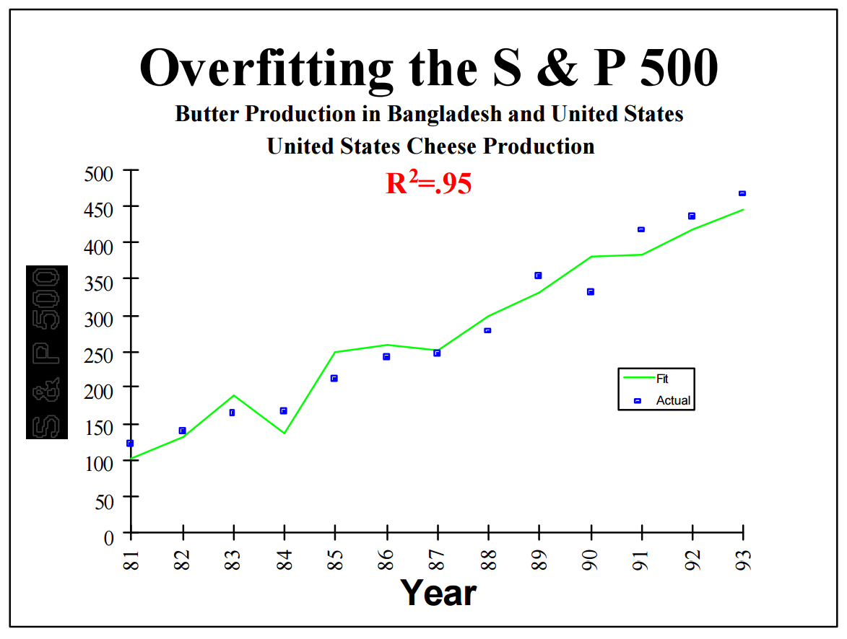

What is the best predictor of S&P 500 Index?

Slide 14
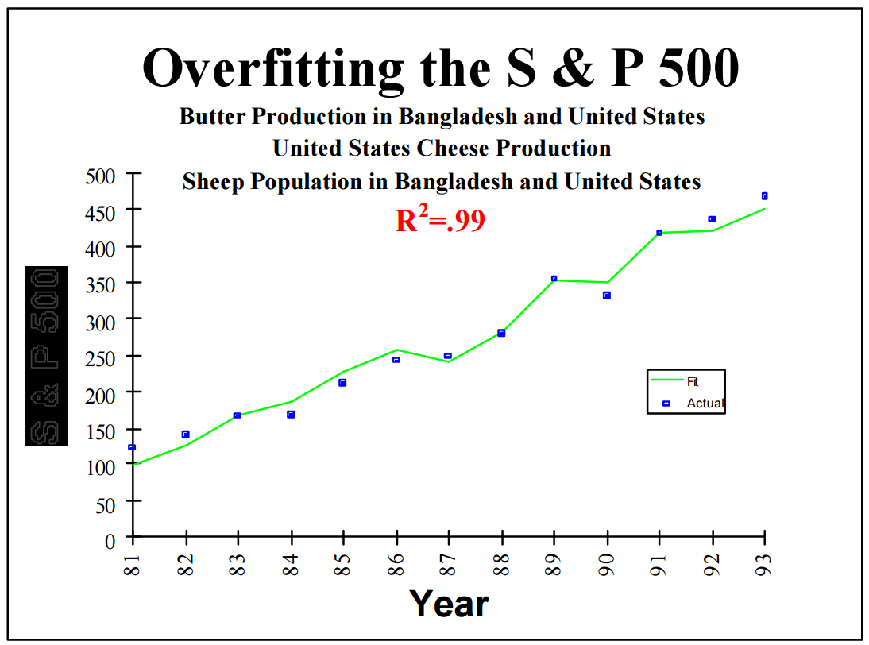

What is the best predictor of S&P 500 Index?

Slide 15
Key Takeaway
Beware of data over-fitting /data over-mining.

Slide 16
Other Pitfalls in Factor Discovering Process
Survivorship bias:
Back-tests with companies that are still in business today
Look-ahead bias
using data or information that was unknown or unavailable at the time an investment decision was made (restated accounting data)
Fail to fully consider transaction costs and short availability
History does not always repeat itself

Slide 17
Discover Return Predictive Factors: Guidance from Valuation Theory
Value of a security should equal to the present value of future cash distributions:
where
V_{t} = Value of a stock at time t
E_{M}[CF_{t+τ}] = Consensus market expectation at time t of cash distribution at time t+τ
r_{M} = market’s required rate of return at time t

Slide 18
What Drives Changes of Stock Prices?
Cum-dividend price change between period t and period t+1 has 3 components:
r_{M} : The expected return that was priced into the stock at period t (“Expected Return”)
Δ_{t,t+1} E_{M}[CF_{t+τ}] : News causing revisions to the market’s cash flow expectations (“Fundamental News”)
Δ_{t,t+1} [r_{M}]: Changes in the market’s required rate of return (“Expected Return News”)

Slide 19
Relative Importance of Return Components
Source: Richardson, Sloan and You, 2012, What makes Stock Prices Move? Financial analyst Journal 68(2).
Expected returns, together with fundamental news explains about 40% of the cross-sectional variation of annual stock returns
Expected returns news is an important driver of the “unexplained area”

Slide 20
Discover Return Predictive Factors: Implication of the Valuation Theory
Three types of potential factors:
Factors that capture the expected returns
Factors that help predict future fundamental news
Factors that help predict future expected return news

Slide 21
Multifactor Quantitative Investing
Key Elements of Quantitative Investing
Alpha
Return Prediction
Evaluate Alpha
Factors
Fundamental News
Fundamental momentum
Build Portfolio with Stock Screen & Multi-Factor Models
Overinvestment
Profitability
Identify Alpha
Factors
(Drivers of stock returns)
Expected Returns
Earnings Quality
Risk
Value Factors
Expected Returns News
Sentiment factors
T-cost
Transaction cost
Technical factors
Notes:
A quick preview of the plan for the quantitative equity investing part of the course.
Start off with a quick discussion of the three key element of quantitative investing.
We then focus on the alpha or the return forecast (or alpha) component.
In order to be able to the search for some alpha factors, you need to know how to evaluate them first. We will first introduce a method and some metrics for alpha factor evaluation.
In guiding the search for alpha factors, we introduce a return decomposition framework. Stock returns are driven by three components, expected return, fundamental news and expected returns news. We are going to forecast future returns by measuring/forecasts the three components. For each component, we will introduce a few factors to measure or predict it.
In the last part of the lecture, we will discuss quickly how to use the identified factors to construct portfolios with simple techniques such as stock screen and stock rank tools.

Slide 22
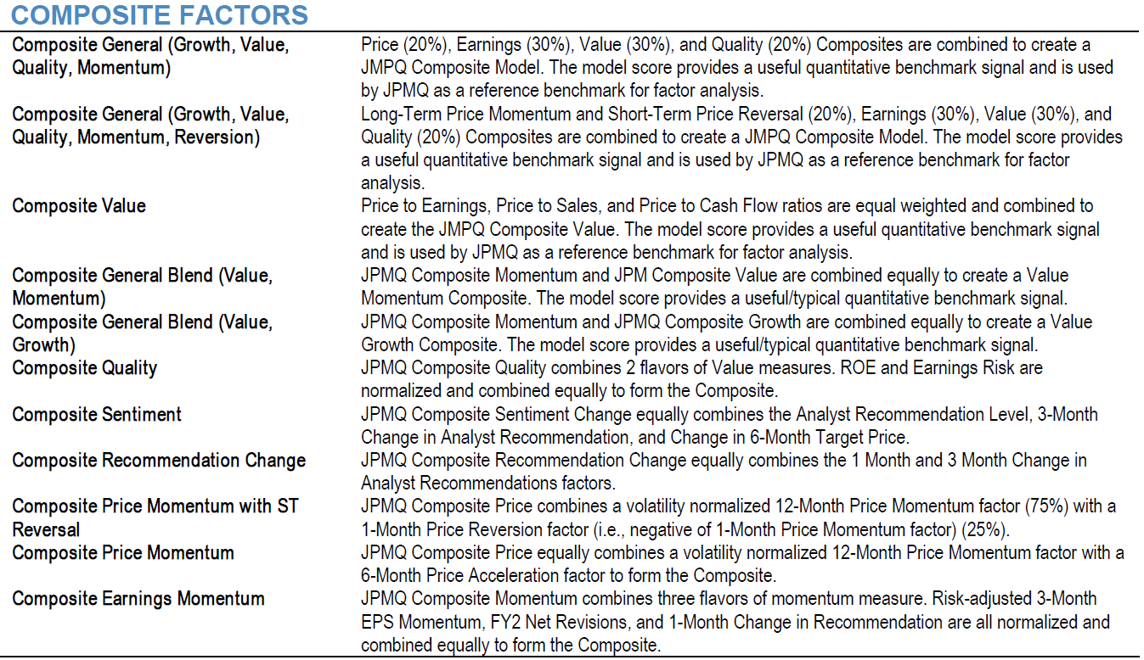
Example: JP Morgan Composite Factor

Slide 23



Evolution of Investment Technology
Traditional Investing
Human intelligence
Adaptive
Low information processing efficiency
High portfolio concentration & risk
Susceptible to emotional biases
Quantitative Investing
Hard-coded expert system
High information processing efficiency
Immune from emotional biases
Diversified portfolios
Limited adaptability
AI Investing
AI/ML technology
Ability to process big/unstructured data
Adaptive and can self-adjust to changing market conditions
Real-time risk control
Low interpretability

Slide 24
AI vs. Traditional Hedge Funds
Source: Eurekahedge. The Eurekahedge AI Hedge Fund Index (Bloomberg Ticker - EHFI817) is an equally weighted index of 14 constituent funds. The index is designed to provide a broad measure of the performance of underlying hedge fund managers who utilize artificial intelligence and machine learning theory in their trading processes.

Slide 25
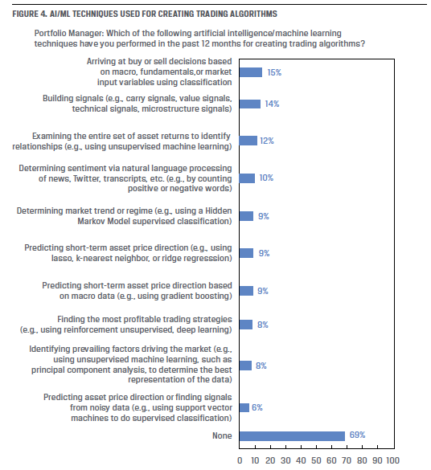
Adoption of AI/ML in the Investment Industry
Source: AI Pioneers in Investment Management, CFA Institute, 2019

Slide 26
Application of AI/ML in Quantitative Investing
Alpha/factor discovery
Factor aggregation
Portfolio optimization
Market timing & factor/industry rotation
….

Slide 27
Multifactor Quantitative Investing
Key Elements of Quantitative Investing
Alpha
Return Prediction
Evaluate Alpha
Factors
Fundamental News
Fundamental momentum
Build Portfolio with Stock Screen & Multi-Factor Models
Overinvestment
Profitability
Identify Alpha
Factors
(Drivers of stock returns)
Expected Returns
Earnings Quality
Risk
Value Factors
Expected Returns News
Sentiment factors
T-cost
Transaction cost
Technical factors
Notes:
A quick preview of the plan for the quantitative equity investing part of the course.
Start off with a quick discussion of the three key element of quantitative investing.
We then focus on the alpha or the return forecast (or alpha) component.
In order to be able to the search for some alpha factors, you need to know how to evaluate them first. We will first introduce a method and some metrics for alpha factor evaluation.
In guiding the search for alpha factors, we introduce a return decomposition framework. Stock returns are driven by three components, expected return, fundamental news and expected returns news. We are going to forecast future returns by measuring/forecasts the three components. For each component, we will introduce a few factors to measure or predict it.
In the last part of the lecture, we will discuss quickly how to use the identified factors to construct portfolios with simple techniques such as stock screen and stock rank tools.

Slide 28
Factor Discovery with Machine Learning
Fundamental news
Cao and You (2021)
Binsbergen, Han, and Lopez-Lira (2021)
Expected returns news
Technical analysis with ML (e.g. Murray et al. 2020; Jiang et al. 2020)
Sentiment analysis with NLP (e.g. Jegadeesh and Wu 2013; Huang et al. 2020; Ke et al. 2020)
Expected returns
Bartram and Grinblatt (2018)
Geertsema and Lu (2020)

Slide 29
ML based Fundamental Analysis

Slide 30
Cao and You (2021)
Examine whether machine learning extracts useful information from financial statements and generates better earnings forecasts
Accuracy, information content, proximity to the market expectation
Potential reasons for the difference in performance
Economic significance of the difference in performance
Shed light on the usefulness of financial statement information and machine learning in fundamental analysis

Slide 31
Model Comparison Framework
Random Walk Model (RW)
OLS
AR
COMP_LR
LASSO
HVZ
COMP_EXT
Ridge
EP
COMP_ML
RI
RF
So
GBR
COMP_NL
ANN

Slide 32
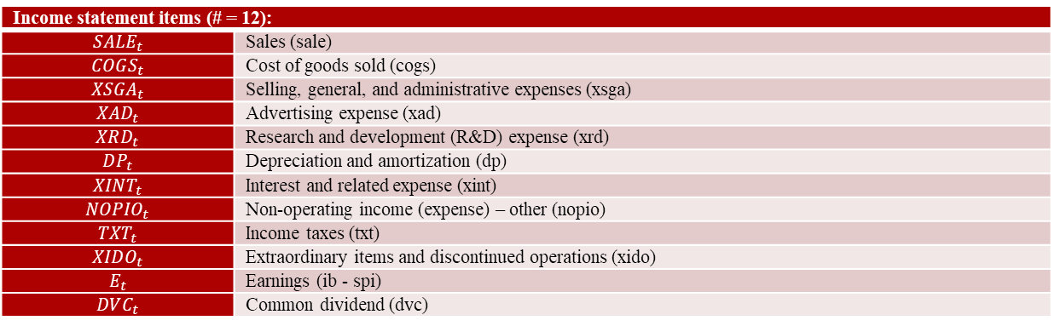
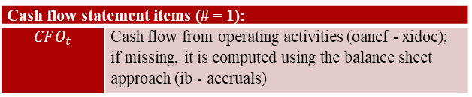
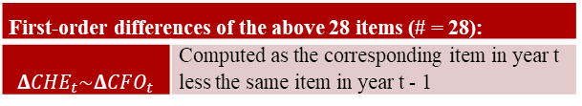
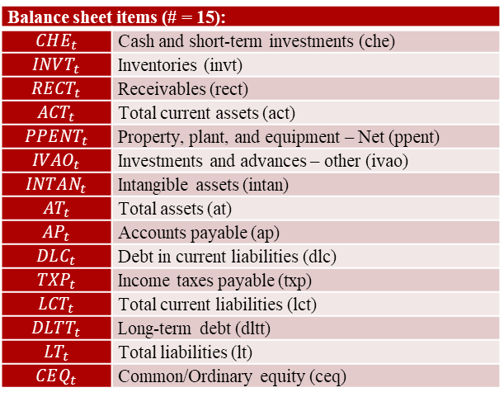
Feature Selection
Income statement items (# = 12):
$$SALE_{t}$$ | Sales (sale)
$$COGS_{t}$$ | Cost of goods sold (cogs)
$$XSGA_{t}$$ | Selling, general, and administrative expenses (xsga)
$$XAD_{t}$$ | Advertising expense (xad)
$$XRD_{t}$$ | Research and development (R&D) expense (xrd)
$$DP_{t}$$ | Depreciation and amortization (dp)
$$XINT_{t}$$ | Interest and related expense (xint)
$${NOPIO}_{t}$$ | Non-operating income (expense) – other (nopio)
$$TXT_{t}$$ | Income taxes (txt)
$$XIDO_{t}$$ | Extraordinary items and discontinued operations (xido)
$$E_{t}$$ | Earnings (ib - spi)
$$DVC_{t}$$ | Common dividend (dvc)
Balance sheet items (# = 15):
$$CHE_{t}$$ | Cash and short-term investments (che)
$$INVT_{t}$$ | Inventories (invt)
$$RECT_{t}$$ | Receivables (rect)
$$ACT_{t}$$ | Total current assets (act)
$$PPENT_{t}$$ | Property, plant, and equipment – Net (ppent)
$$IVAO_{t}$$ | Investments and advances – other (ivao)
$$INTAN_{t}$$ | Intangible assets (intan)
$$AT_{t}$$ | Total assets (at)
$$AP_{t}$$ | Accounts payable (ap)
$$DLC_{t}$$ | Debt in current liabilities (dlc)
$$TXP_{t}$$ | Income taxes payable (txp)
$$LCT_{t}$$ | Total current liabilities (lct)
$$DLTT_{t}$$ | Long-term debt (dltt)
$$LT_{t}$$ | Total liabilities (lt)
$$CEQ_{t}$$ | Common/Ordinary equity (ceq)
Cash flow statement items (# = 1):
$$CFO_{t}$$ | Cash flow from operating activities (oancf - xidoc); if missing, it is computed using the balance sheet approach (ib - accruals)
First-order differences of the above 28 items (# = 28):
$$ΔCHE_{t}\sim ΔCFO_{t}$$ | Computed as the corresponding item in year t less the same item in year t - 1

Slide 33
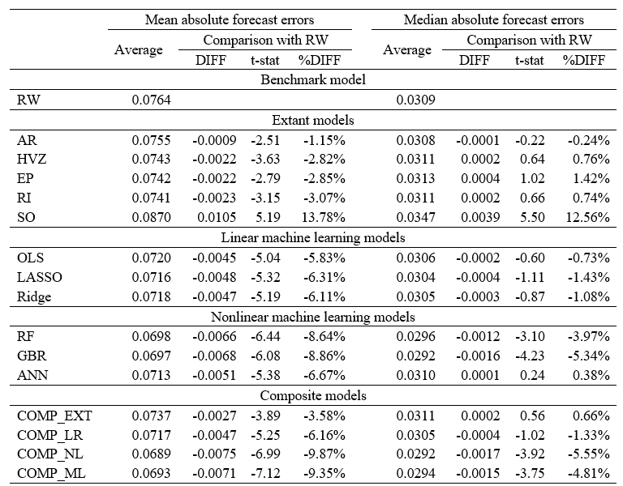
Table 2: Comparison of forecast accuracy

Slide 34
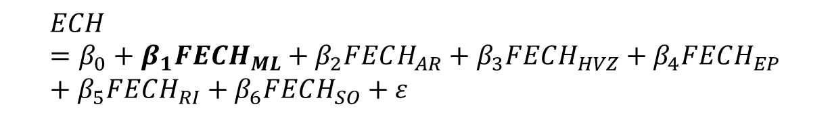
Information Content Analysis
The ability of forecasted earnings change (FECH) to predict actual earnings change (ECH):
Pearson and Spearman correlations
Univariate regressions of ECH on FECH.
Multivariate regressions:
$$ECH=β_{0}+β_{1}FECH_{ML}+β_{2}FECH_{AR}+β_{3}FECH_{HVZ}+β_{4}FECH_{EP}+β_{5}FECH_{RI}+β_{6}FECH_{SO}+ε$$

Slide 35
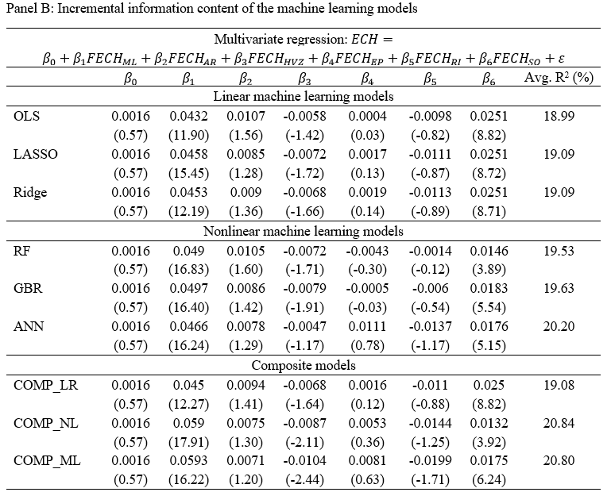
Table 4, Panel B

Slide 36
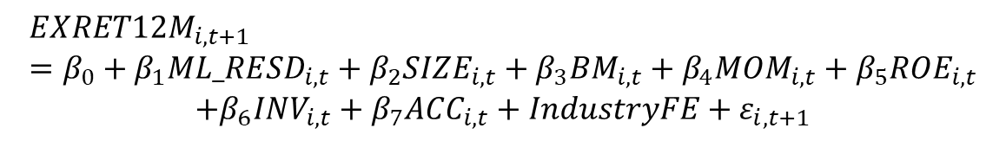
Usefulness of Machine learning Forecasts for Return Prediction
New information uncovered by the machine learning models
Residuals from the cross-sectional regression of the machine-learning-based forecasts against the forecasts generated using the RW model and the extant models.
Fama-MacBeth regression analysis
Portfolio analysis
Equal-weighted portfolios and value-weighted portfolios
$$EXRET12M_{i,t+1}=β_{0}+β_{1}ML_RESD_{i,t}+β_{2}SIZE_{i,t}+β_{3}BM_{i,t}+β_{4}MOM_{i,t}+β_{5}ROE_{i,t}$$
$$+β_{6}INV_{i,t}+β_{7}ACC_{i,t}+IndustryFE+ε_{i,t+1}$$

Slide 37
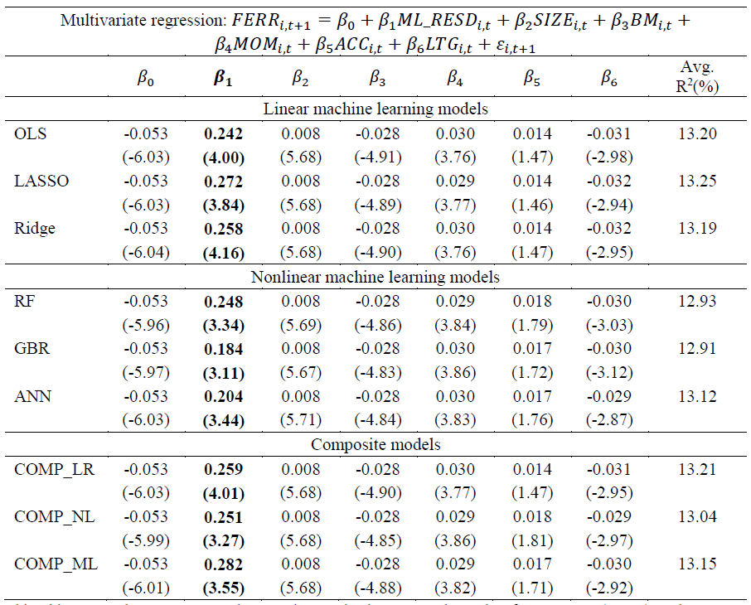
Table 8: Regression of analyst forecast errors on the new information uncovered using the machine learning models

Slide 38
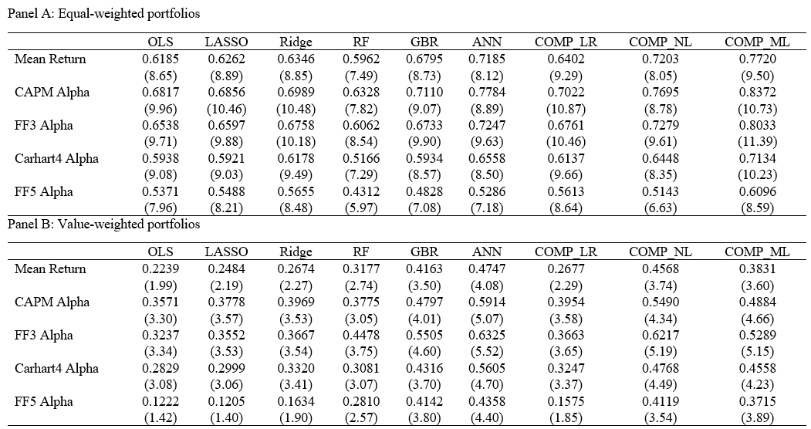
Table 7: Portfolio analysis of the new information uncovered using the machine learning models

Slide 39
Man vs. Machine Learning: The Term Structure of Earnings Expectations and Conditional Biases
By Jules H. van Binsbergen, Xiao Han, and Alejandro Lopez-Lira
Forecast earnings using information in financial statements, macroeconomic variables, and analysts' predictions
Machine learning model: Random forest regression
Assess bias in analyst forecasts by comparing analysts’ forecasts to machine learning forecasts
Biases increase with forecast horizon
High bias predicts lower future stock returns

Slide 40
Variables Used for Earnings Forecasts- Firm Fundamentals:
1. Realized earnings from the last period. Earnings data are obtained from /I/B/E/S
2. Earnings growth, defined as the growth rate in earnings
3. Sales growth, defined as the growth rate in sales and obtained from COMPUSTAT
4. Asset growth, defined as the growth rate in total assets and obtained from COMPUSTAT
5. Investment growth, defined as the growth rate in capital expenditure and obtained from COMPUSTAT
6. Monthly stock prices and returns from CRSP
7. Sixty-seven financial ratios such as book-to-market ratio and dividend yields obtained from the Financial Ratios Suit by Wharton Research Data Services.

Slide 41
Variables Used for Earnings Forecasts- Macroeconomic Variables & Analyst Forecasts:
Macroeconomic variables from the Federal Reserve Bank of Philadelphia:
1. Consumption growth, defined as the log difference of consumption in goods and services
2. GDP growth, defined as the log difference of real GDP
3. Growth of industrial production, defined as the log difference of Industrial Production Index (IPT)
4. Unemployment rate
Analysts’ one-year ahead EPS forecasts

Slide 42
Random Forest Regression
Random forest regression model to forecast earnings from January 1987:
Hyperparameters are determined using data of 1986
Model retrained each month from January 1987
Define bias as:

Slide 43
Table 4: Fama-MacBeth Regression of Future Returns on BE and Control Variables
BE Score: the arithmetic average of the percentile rankings of the five conditional biases

Slide 44
Portfolio Analysis of BE Score

Slide 45
Time-Series Tests with Multi-Factor Models

Slide 46
Other Approaches
Using machine learning based earnings forecasts as valuation inputs (Binz, Schipper and Standridge 2021)
Relative Valuation with Machine Learning (based on fundamentals (Geertsema and Lu 2020)
Predicting accounting fraud/misstatement (earnings quality) using machine learning (Bao et al. 2019; Bertomeu et al. 2020)

Slide 47
ML based Technical Analysis

Slide 48
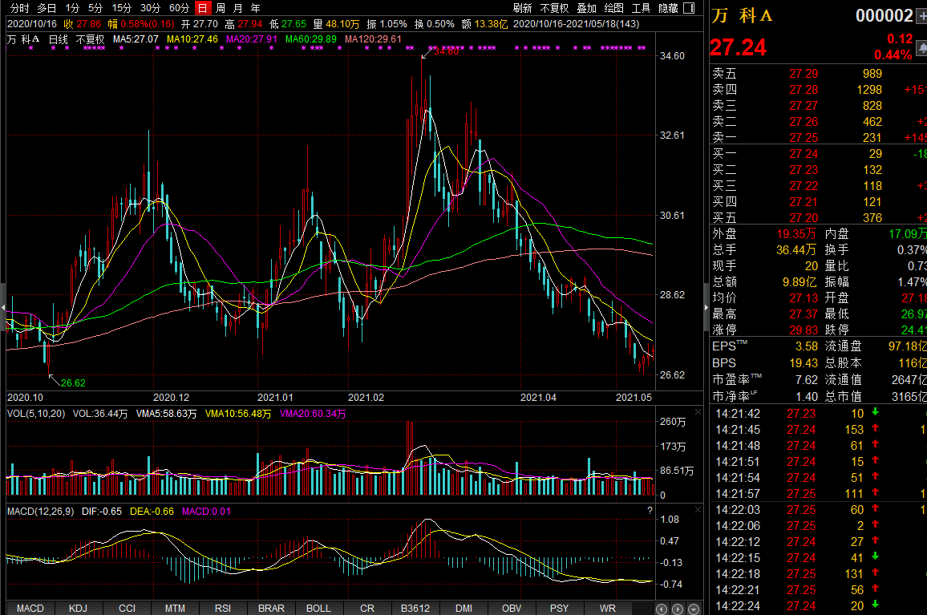
Price Charts

Slide 49
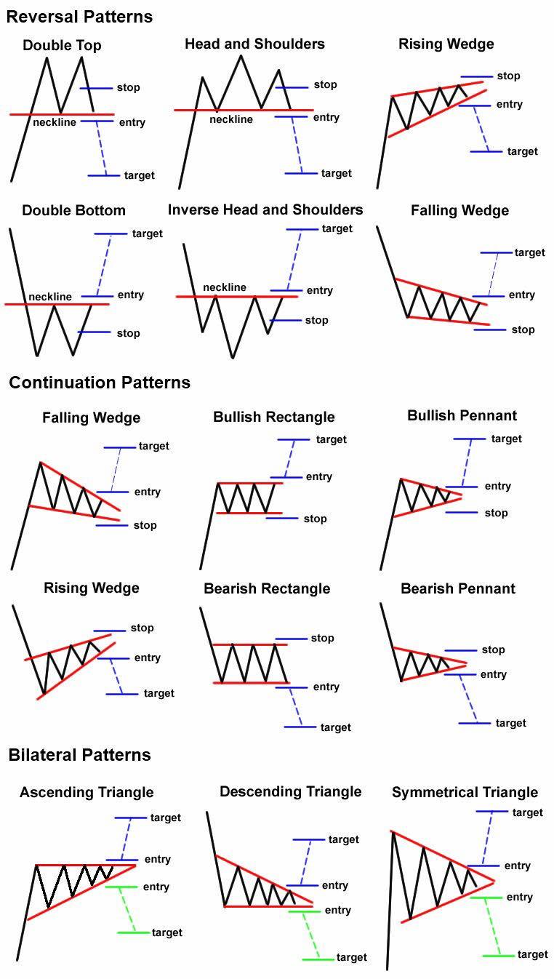
Technical Analysis & Price Patterns

Slide 50
Research on Technical Analysis
Stock Selection:
Short-term reversal (e.g. Fama 1965; Jegadeesh 1990)
Medium-term momentum (e.g. Jegadeesh and Titman 1993)
Long-term reversal (De Bondt and Thaler 1985)
Trend factor with moving averages (Han, Zhou, Zhou 2016)
Market timing:
Moving average, momentum and volume based indicators (Neely, Rapach, Tu and Zhou 2014)
…
Machine learning based technical analysis
Charting By Machines, by Murray, Xiao and Xia (2020)
(Re-)Imag(in)ing Price Trends, by Jiang, Kelly and Xiu (2020)

Slide 51
Murray et al. (2020)
Forecast future stock returns from historical price plots using machine learning
Features: Cumulative returns of individual stocks over the month t-12 through t-1:
CR1: t-12
CR2: t-12 to t-11
…
CR12: t-12 to t-1
Machine Learning models:
Feed-forward neural network (FNN)
Convolutional neural network (CNN)
Long-short term memory (LSTM)
Convolutional neural network with long-short term memory (CNNLSTM)

Slide 52
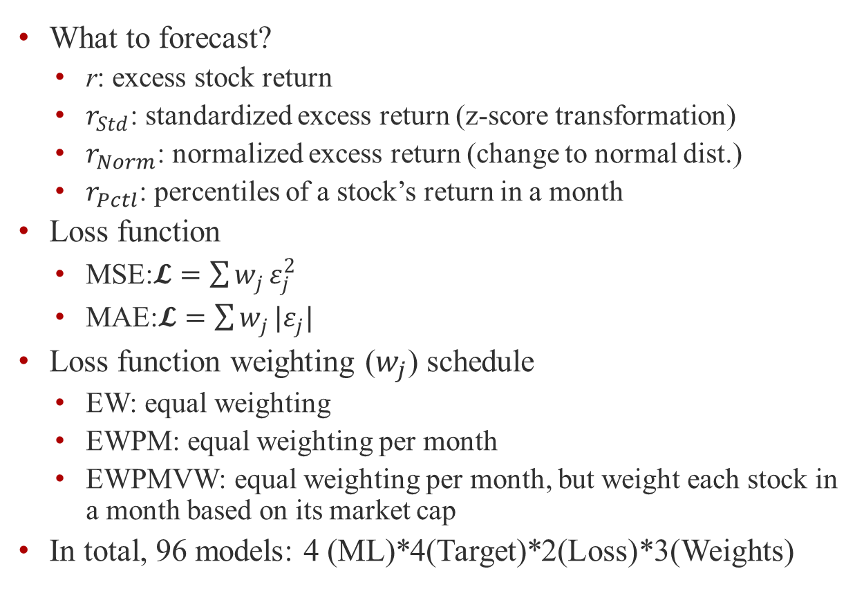
Murray et al. (2020) Research Design Issue
What to forecast?
r: excess stock return
$r_{Std}$: standardized excess return (z-score transformation)
$r_{Norm}$: normalized excess return (change to normal dist.)
$r_{Pctl}$: percentiles of a stock’s return in a month
Loss function
MSE:$𝓛=\sum{w_{j}}ε_{j}^{2}$
MAE:$𝓛=\sum{w_{j}}|ε_{j}|$
Loss function weighting ($w_{j}$) schedule
EW: equal weighting
EWPM: equal weighting per month
EWPMVW: equal weighting per month, but weight each stock in a month based on its market cap
In total, 96 models: 4 (ML)*4(Target)*2(Loss)*3(Weights)

Slide 53
Murray et al. (2020) Research Design Issue
Optimization period: 192701-196306
Training Sample: Even months from even years & odd months from odd years
Validation sample: Other months in the optimization period
Testing period: 196307-201912
Model evaluation/selection: time-series average of the monthly cross-sectional Spearman rank correlation (i.e. Spearman IC)

Slide 54
Table 1: ML Process Optimization
Generate machine learning based forecast, MLER, using (CNNLSTM, MSE, EWPM, and rNorm)

Slide 55
Table 3: Portfolio Analysis

Slide 56
Table 9: Non-Linearity of ML-based Forecasts

Slide 57
From Features to Pictures
Feature engineer (e.g. breaking down stock returns into predefined intervals)
Helps reduce the dimension of predictors and overfitting
It may also lead to loss of information
Can machine learning extract more flexible/subtle patterns from historical price/volume that are useful for return prediction?
(Re-)Imag(in)ing Price Trends, by Jiang, Kelly and Xiu (2020)

Slide 58
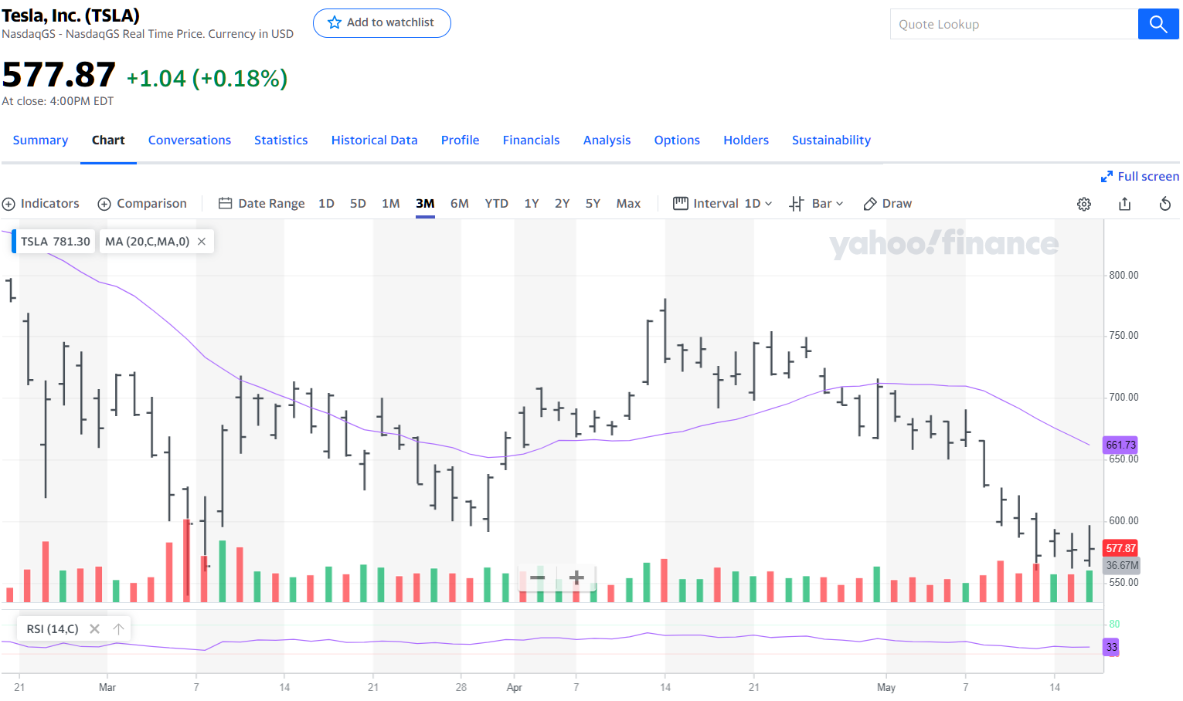
Jiang, Kelly and Xiu (2020) Research Design: Inputs

Slide 59
Jiang et al. (2020) Research Design
Sample: NYSE, AMEX, and NASDAQ
Sample period: 1993-2019
Training & Validation:
1993 to 1999
70% training & 30% for validation (randomly)
Test sample: 2000-2019
Target variable: y=1 if subsequent return is positive and y=0 otherwise

Slide 60
Out-of-Sample Classification Accuracy

Slide 61
Portfolio Analysis (Equal Weight Portfolios)

Slide 62
Portfolio Analysis (Valule Weight Portfolios)

Slide 63
Short-horizon Portfolio Analysis

Slide 64
Transfer Learning and International Market Performance

Slide 65
Sentiment Analysis with NLP

Slide 66
Textual Data and NLP
According to IDC, the size of digital data will be 40 zettabytes by 2020, more than 5,200 gigabytes for every person in the world.
Much of its is text from various sources such as web, social media, newswire, emails, regulatory documents…
How do investors make sense of text data?
Natural Language Processing (NLP) helps to convert texts (unstructured) into an easier to use format (structured).

Slide 67
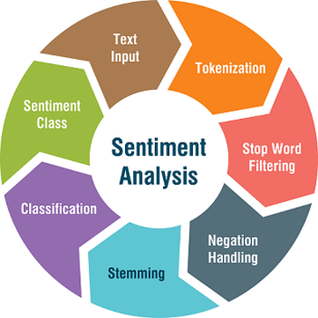
NLP and Sentiment Analysis
Data Preprocessing
Tokenization: covert sentences to words
Remove stop words-frequent words such as “the”, “is”, etc.
Stemming and lemmatization: reduce words to its root (playing, plays, played=> play)
Sentiment Analysis
Dictionary based approach: positive/negative words: https://sraf.nd.edu/textual-analysis/resources/
Machine learning approach:
Feature extraction: mapping text to real value vector (Bag of Words and Word2vec etc.)
Train a machine learning algorithm

Slide 68
Selected Research on Sentiment Analysis
Sentiment in news predict short-term stock returns:
Tetlock (2007): WSJ’s “Abreast of the Market” column
Tetlock, Sarr-Tsechansky, and Macskassy (2008): all WSJ and Dow Jones News Service news
Tone in earnings press release (Henry 2008)
Tone in 10-K/Q filing:
Management discussion and analysis (MD&A) section of : (Feldman, Govindaraj, Livnat, and Segal 2010; Li 2010)
10-K Filings (Loughran and McDonald 2011)
Conference calls (prepared remarks and Q&As) (Brockman, Li, and Price 2015)
Social media sentiment:
Bollen, Mao and Zeng (2011): Twitter feeds
Chen, De, Hu and Hwang (2014): Seeking Alpha websites

Slide 69
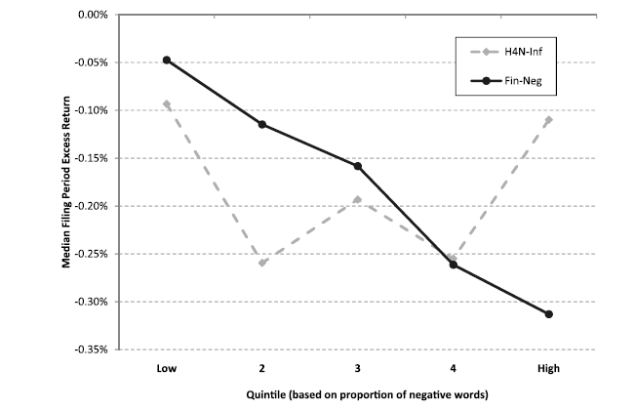
Dictionary based measure of sentiment
Harvard General Inquirer list: http://www.wjh.harvard.edu/∼inquirer
Loughran and McDonald (2011)
A word list developed for psychology and sociology may not translates well into business, for example, tax, cost, capital, board, liability, foreign, and vice are negative on the Harvard list
Create a list of 2,354 words that typically have negative implications in a financial sense, and a list of 354 positive words (https://sraf.nd.edu/textual-analysis/resources/)

Slide 70
Word power: A New approach for content analysis, by Jegadeesh and Wu (2013)
Not all positive (negative) words are equally good (bad), e.g. bad vs worst, thus, the weight on each word should be different too
When assign a positive/negative sentiment score, it should satisfy the following properties:
The score should be positively related to the number of occurrence of each positive or negative word
The score should be positively related to the strength of the positive or negative words
The score should be inversely related to the total number of words in the documents.

Slide 71
Estimation of the weight/strength
Determine the weight/strength of words based on market reaction to 10-K filings.
Assumption: the market reaction would be more positive for filings with more positive overall sentiment.
Using both the Loughran and McDonald (2011) wordlist and the global list, which combine i) LM list, ii) the Harvard IV-4 dictionaries, the top and bottom 200 words from the word list developed by Bradley and Lang (1999).

Slide 72
Sentiment Score/Word Power and 10-K Filing Period Abnormal Returns

Slide 73
Sentiment Score and Future Stock Returns

Slide 74
FinBert by Huang, Wang and Yang (2020)
BERT (Bidirectional Encoder Representations from Transformers), Google’s state-of-the-art language model for NLP, which learn the language model by:
Masked Language Modeling (LM): randomly mask 15% of the words with a [MASK] token, and then attempts to predict the original value of the masked words, based on the context provided by the other, non-masked words in the sequence
Next Sentence Prediction (NSP): the model receives pairs of sentences as input and learns to predict whether the 2nd sentence in the pair is the subsequent sentence in the original document.

Slide 75
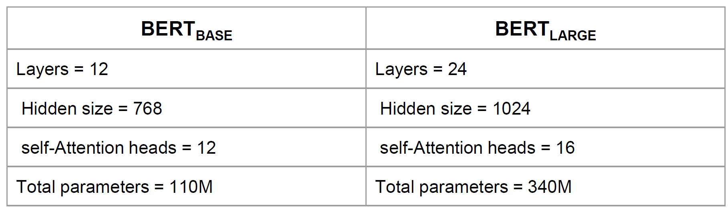
BERT Fine-Tuning for Specific Tasks
Google pre-trained two BERT models using general text copus from Wikipedia and BooksCorpus with a total of 3.3 billion word tokens:
Using transfer learning, users can fine-tune the pre-trained model for specific tasks such as sentiment analysis, question-answering tasks, and named entity recognition etc.
Sentiment analysis: adding a classification layer on top of the transformer output to predict sentiment labels (by human), just like the Next Sentence classification
Huang et al. (2020)
Pre-train the FinBERT based on the pretrained BERT by google using financial text in 10-K, 10-Q, Earnings conference call and Analyst Report
Fine-tune the FinBERT model for sentiment classification using a sample of 10,000 pre-labeled sentences from financial text

Slide 76
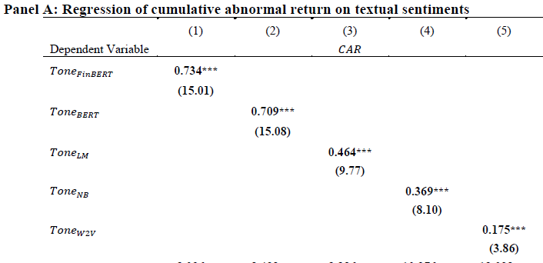
Performance of Sentiment Score of FinBERT
Sentiment classification accuracy
FinBERT: 88.4%, Loughran and McDonald: 61.7%, BERT: 85.5%, Naïve Bayes: 82.7%, Word2Vec 50.9%
FinBERT based sentiment score has higher association with market reaction to conference calls and abnormal trading volume
FinBERT based sentiment score also predict future earnings better than the sentiment score based on the LM dictionary

Slide 77
Other Approaches
SESTM by Ke, Kelly, and Xiu (2020)
Identify the sentiment-charged dictionary S using frequency and return thresholds.
Estimate the vectors of positive and negative sentiment topics by regressing word frequencies on sentiment ranks.
Predict sentiment score of a new article using Maximum Likelihood Estimation (MLE) with a penalty term.
FarmPredict by Fan, Xue and Zhou (2021)
Extract hidden topics (factors) from all words (PCA)
Screen the idiosyncratic variables by their correlation with stock returns.
Apply simple LASSO to predict asset price using hidden factors and screened idiosyncratic components.

Slide 78
Thank You!

